Slide 1
GPU, Chapter 3 (Review)

Slide 2
What Next
Wednesday – 6.6 and review of chapter 3
Thursday – Review Chapter 1
Monday – Review Chapter 2
Wednesday – Review Chapter 4
Happy Exam ..

Slide 3
GPU – Graphics Processing Units
Microprocessors were connected to graphics displays
Increasing fraction of processing time was used for graphics
Major driving force for improving graphics processing was the computer game industry.

Slide 4
CPU VS GPU
Central Processing Unit Vs Graphics Processing Unit
Is the brain vs accelerator (soul) of this brain.
CPU is comprised of cores designed for sequential serial processing, vs the GPU is designed with a parallel architecture consisting of more efficient yet smaller cores that can easily handle multiple tasks in parallel.
CPU rely on multi level cache vs GPU hardware multithreading.
The GPU memory is thus oriented toward bandwidth (bytes/second) rather than latency.
Less core, serial vs more core, parallel

Slide 5
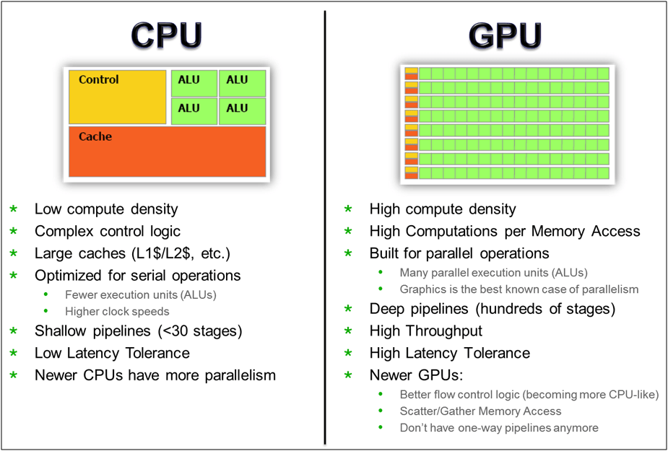
CPU vs GPU

Slide 6
GPU – Main attraction
Although GPUs were designed for a narrower set of applications, programmers wanted to specify their applications in a form that would let them tap the high potential performance of GPUs.
CUDA(Compute Unified Device Architecture), OpenCL
GPU is a
Graphics Controller
Programmable and Powerful Computational device.

